Slide 1
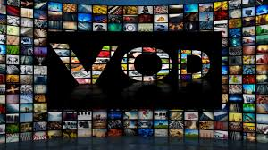
VIDEO ON DEMAND
Developed By:- DEEPINDER SINGH
GULMEHAK KAUR
SHRISH SAINI

Slide 2
VIDEO ON DEMAND
Introduction:-
Video on demand is a system that allows users to select and watch video content of their choice on their TVs or computers. Video on demand is one of the dynamic features offered by Internet Protocol TV. VOD is basically the opposite of live streaming giving users the opportunity to watch video at any suitable time and from any Internet-connected devices
Benefits:-
Here are five benefits of video on demand over linear TV you should know of if you are thinking of being a traditional TV alternative connoisseur
Convenience
Connectivity
Cost
Variety
Devices

Slide 3
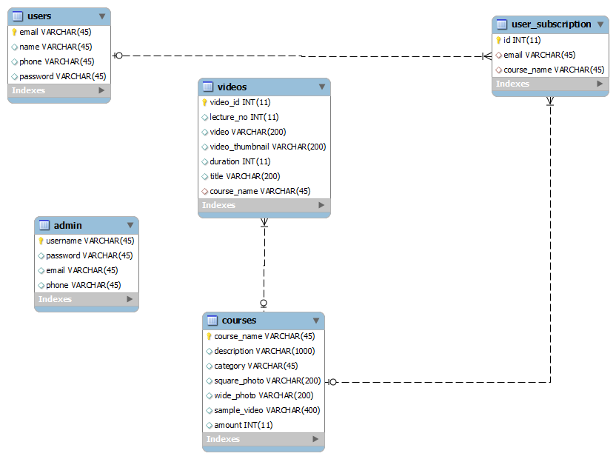
VIDEO ON DEMAND

Slide 4
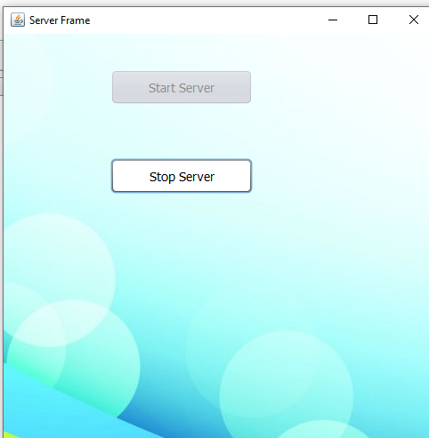
VIDEO ON DEMAND

Slide 5
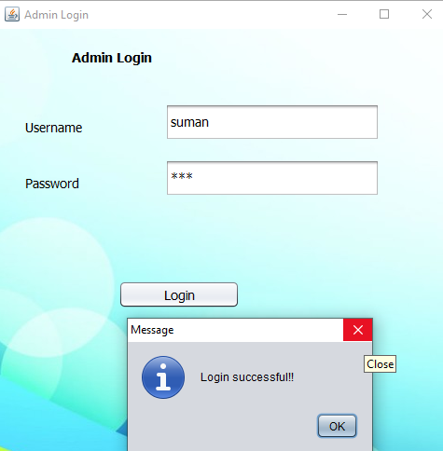
VIDEO ON DEMAND

Slide 6
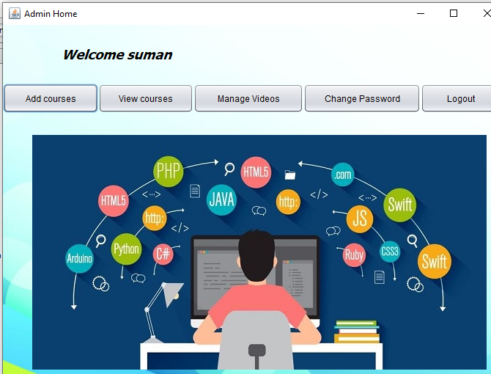
VIDEO ON DEMAND

Slide 7
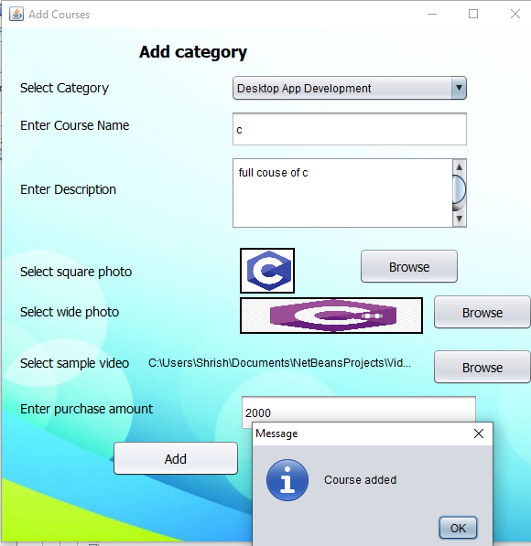
VIDEO ON DEMAND

Slide 8
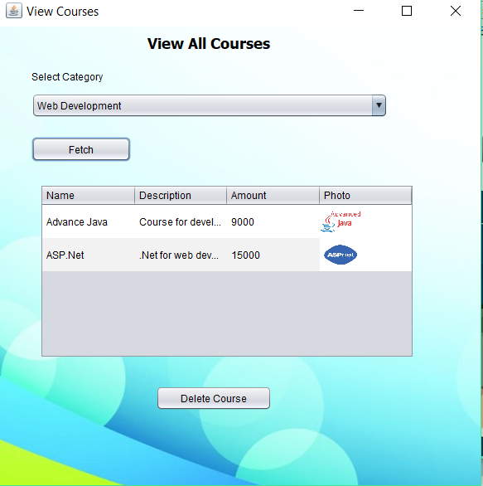
VIDEO ON DEMAND

Slide 9
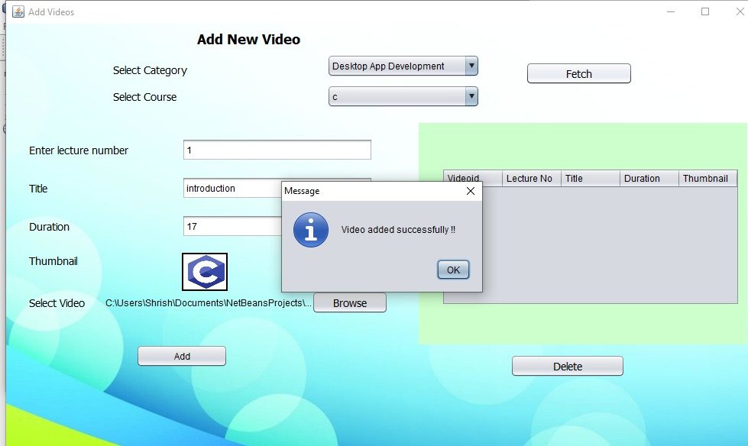
VIDEO ON DEMAND

Slide 10
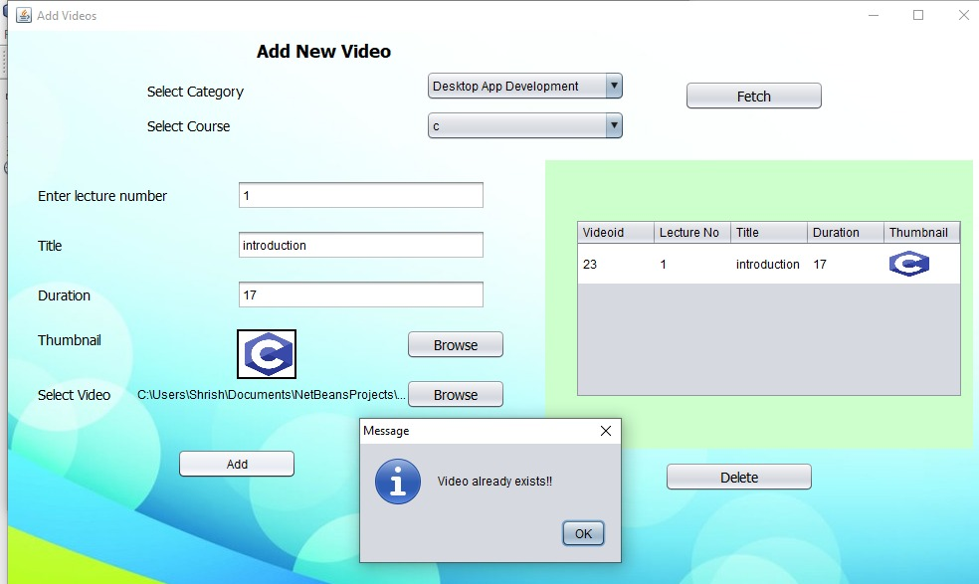
VIDEO ON DEMAND

Slide 11
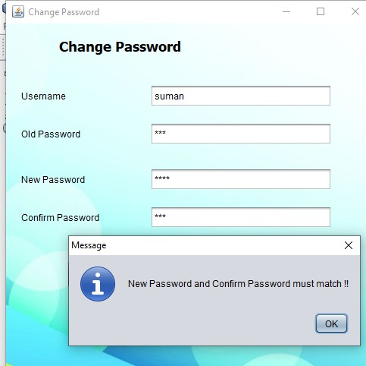
VIDEO ON DEMAND

Slide 12
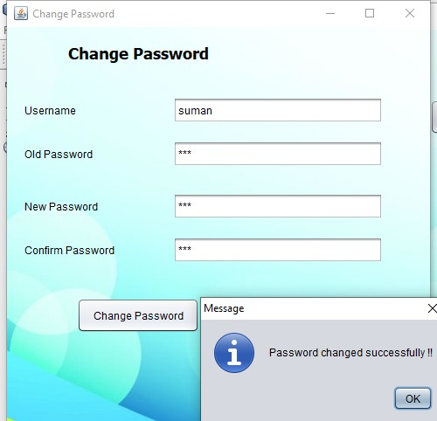
VIDEO ON DEMAND

Slide 13
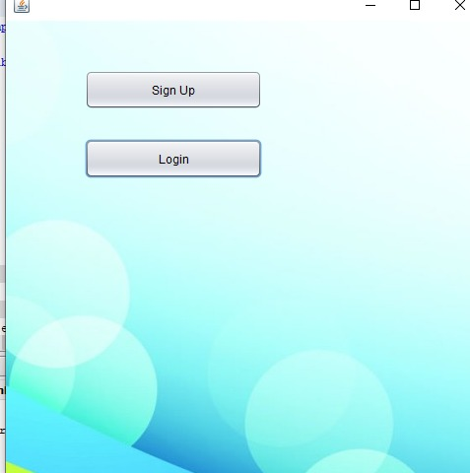
VIDEO ON DEMAND

Slide 14
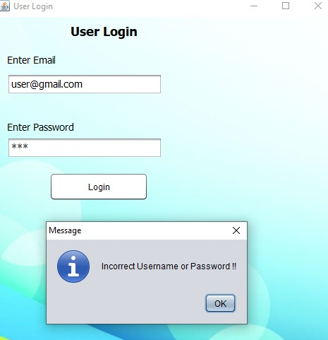
VIDEO ON DEMAND

Slide 15
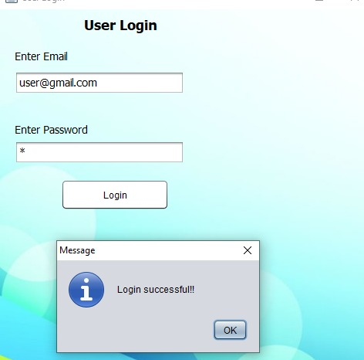
VIDEO ON DEMAND

Slide 16
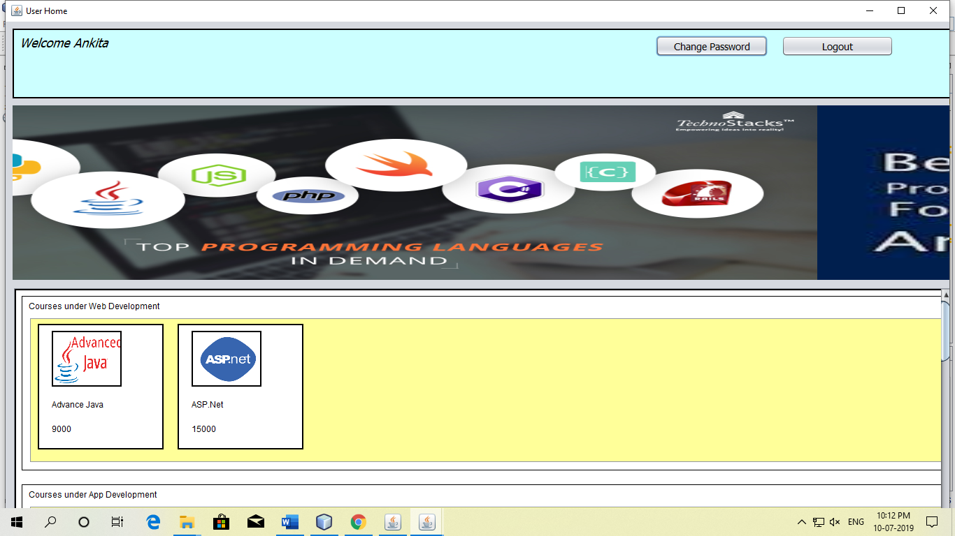
VIDEO ON DEMAND

Slide 17
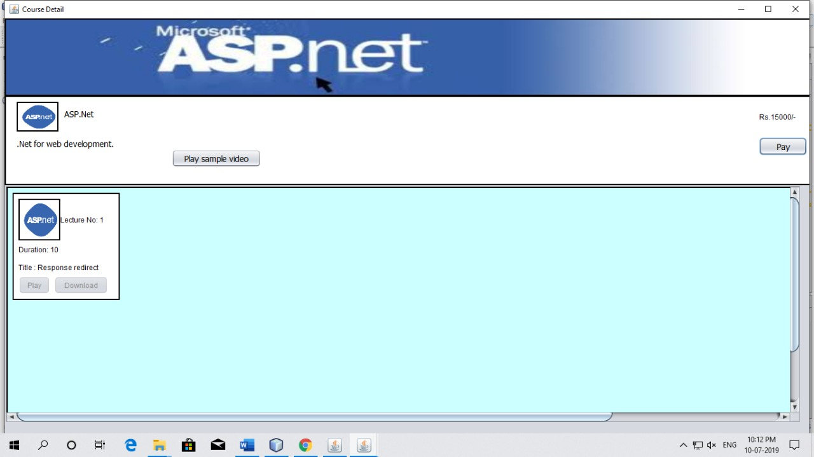
VIDEO ON DEMAND

Slide 18
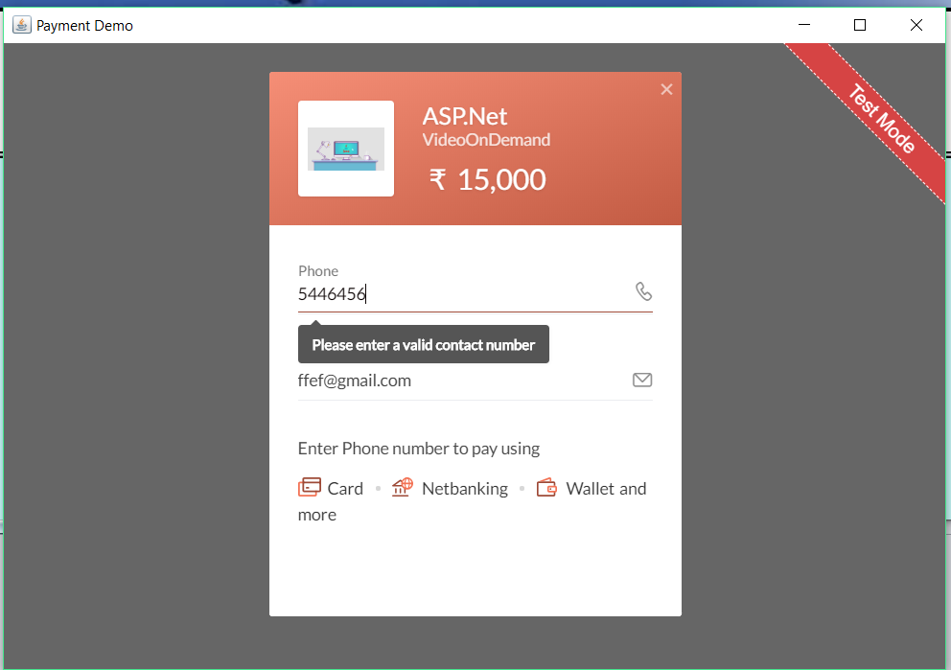
VIDEO ON DEMAND

Slide 19
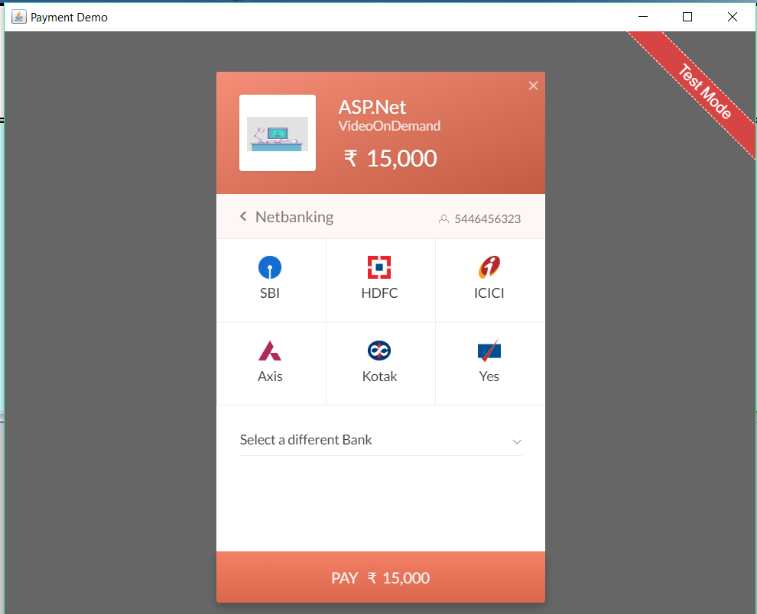
VIDEO ON DEMAND

Slide 20
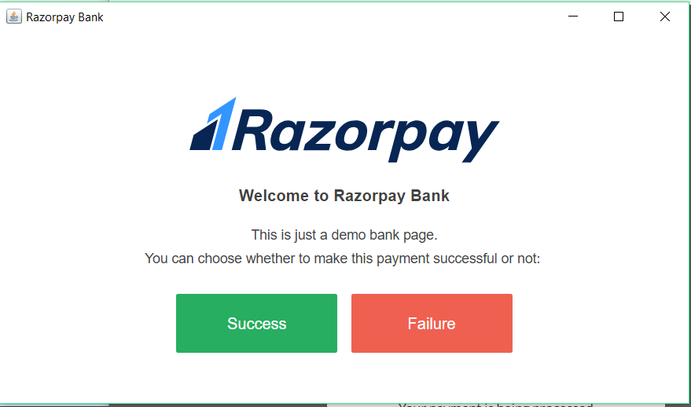
VIDEO ON DEMAND

Slide 21
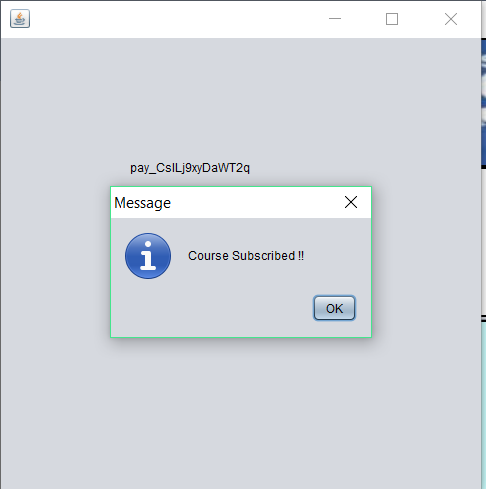
VIDEO ON DEMAND

Slide 22
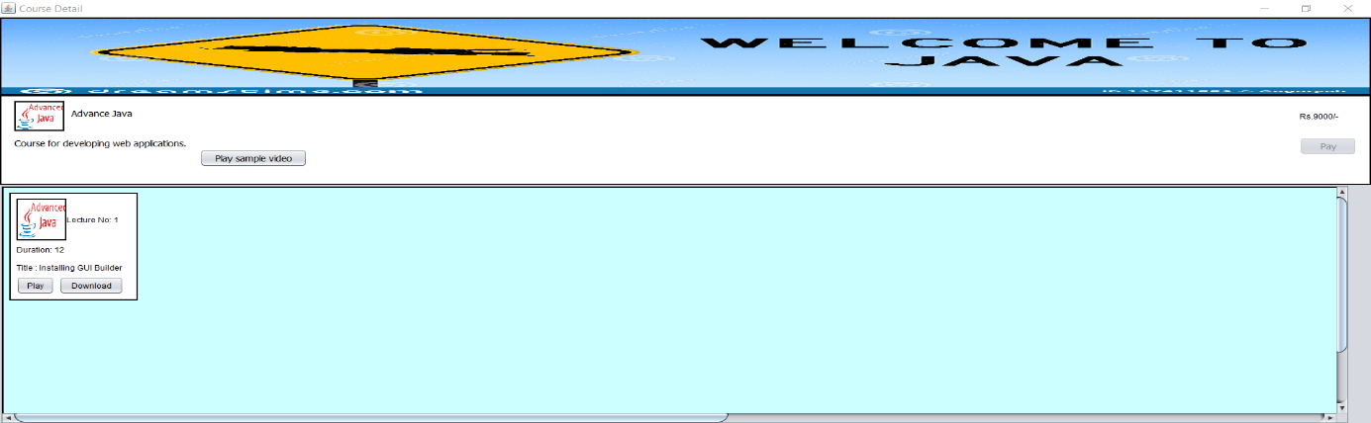
VIDEO ON DEMAND

Slide 23
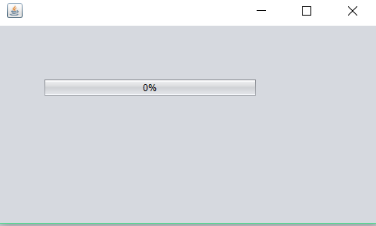
VIDEO ON DEMAND

Slide 24
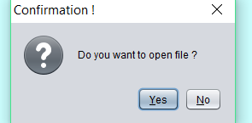
VIDEO ON DEMAND

Slide 25

Developed By:-
DEEPINDER SINGH
GULMEHAK KAUR
SHRISH SAINI

